Slide 1

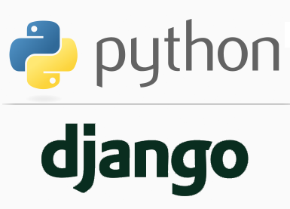
FULL STACK WEB DEVELOPMENT WITH DJANGO
Lecture 19

Slide 2

Today’s Agenda
Developing Our Django App
Getting User Input
Handling HTML Forms

Slide 3
Information About Submitted Data
Beyond basic metadata about the request, HttpRequest object has two attributes that contain information submitted by the user: request.GET and request.POST.
Both of these are dictionary-like objects that give us access to GET and POST data.
POST data generally is submitted from an HTML <form>, while GET data can come from a <form> or the query string in the page’s URL.

Slide 4
Form Handling In Django
As we know all the user input in HTML is always handled using HTML forms.
Django provides us 2 ways to deal with forms in our Django app:
1. By writing <form> tag
2. By using Django's form library called django.forms
Initially we will use the first approach and build a sample app , and then we will use the Django forms library

Slide 5
Form Handling In Django
Continuing the ongoing example of books, let’s create an app that lets users search our book database by subject.
Generally, there are two parts to developing a form:
the HTML user interface and
the backend view code that processes the submitted data.
Let us begin the app by performing the usual initial steps as listed in the next slide

Slide 6
Performing Initial Steps
Create a folder called myeleventhvsdjangoproject in djangoexamples.
Load it in the VS CODE
Create a django project called formdemoproj1 by using the command:
django-admin startproject formdemoproj1
This will create the outer project folder called formdemoproj1 and inner app folder also by the same name

Slide 7
Performing Initial Steps
Now go to the outer project folder formdemoproj1 and create an app called formdemoapp1 by using the command:
django-admin startapp formdemoapp1
Now create a folder called templates in the outer project folder called templates and inside templates create a folder called formdemoapp1 and within it create 3 HTML files called addbook_result.html, search_form.html,search_result.html
Finally update settings.py so that it contains the name of our app and the template directory path

Slide 8
Performing Initial Steps
Code:
INSTALLED_APPS = [
'django.contrib.admin',
'django.contrib.auth',
'django.contrib.contenttypes',
'django.contrib.sessions',
'django.contrib.messages',
'django.contrib.staticfiles',
‘formdemoapp1',
]

Slide 9
Performing Initial Steps
Code:
TEMPLATES = [
{
'BACKEND': 'django.template.backends.django.DjangoTemplates',
'DIRS': [os.path.join(BASE_DIR,'templates')],
…..
}

Slide 10
Performing Initial Steps
Now create a Book Model to represent Book table in the database.
Following is the structure we want for our Book table
Column Name | Data Type | Description
Book_id | Number | To store unique book id
Book_name | Varchar2 | To store name of the book
Book_price | Number | To store price of the book
Subject | Varchar2 | To store subject name of the book
Pub_date | Date | To store date of publishing

Slide 11
Performing Initial Steps
Open the models.py file in our formdemoapp1 folder and add the following model code:
formdemoapp1/models.py
from django.db import models
class Book(models.Model):
book_id=models.IntegerField()
book_name=models.TextField()
book_price=models.FloatField()
subject=models.CharField(max_length=30)
pub_date=models.DateField()

Slide 12
Performing Initial Steps
Now that we’ve created the Book model, we should now sync it with the database using migrations.
Make sure the virtual environment is running and then change into the formdemoproj1 directory.
From the VS command prompt, run:
python manage.py makemigrations formdemoapp1
Hit enter, and then run:
python manage.py migrate formdemoapp1

Slide 13
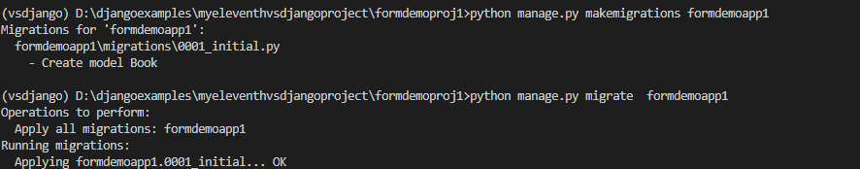
Performing Initial Steps

Slide 14
Performing Initial Steps
After we have synced the model with the database , our next task is to add some book objects to the database using Django’s database API

Slide 15
Performing Initial Steps
Adding Records In The DB:
For adding records in the database through our view function , we have to take following steps:
Import the required model
Create an instance of the model class and then initialize it by passing the data as key-value pair where key name will be column name as set in the model class and value will be the data we have passed.
Call the save( ) method using the model object. This method is inherited from the class models.Model in our model class.

Slide 16
Performing Initial Steps
Based on our previous discussion , let’s add records to the database using our Book model.
Following are the steps needed :
Go to views.py and create a view named addBooksView()
The function addBooksView() will add 6 book records to the database with the following values:

Slide 17
Performing Initial Steps
book_id | book_name | book_price | subject | pub_date
101 | Let Us C | 250.0 | C | 2001-01-15
102 | Mastering Python | 450.0 | Python | 2014-10-21
103 | Python Projects | 350.0 | Python | 2016-04-09
104 | Let Us C++ | 350.0 | C++ | 2006-04-19
105 | Mastering C | 340.0 | C | 2014-12-22
106 | Learning Java | 650.0 | Java | 2018-11-19
It will then retrieve number of books in the database and redirect the request to the template addbook_result.html along with the book count

Slide 18
Performing Initial Steps
views.py
from django.shortcuts import render
from django.http import HttpResponse
from formdemoapp1.models import Book
def addBooksView(request):
book1=Book(book_id=101,book_name="Let Us C",book_price=250.0,subject="C",pub_date="2001-01-15")
book1.save()
book2=Book(book_id=102,book_name="Mastering Python",book_price=450.0,subject="Python",pub_date="2014-10-21")
book2.save()
book3=Book(book_id=103,book_name="Python Projects",book_price=350.0,subject="Python",pub_date="2016-04-09")
book3.save()
book4=Book(book_id=104,book_name="Let Us C++",book_price=350.0,subject="C++",pub_date="2006-04-19")
book4.save()

Slide 19
Performing Initial Steps
book5=Book(book_id=105,book_name="Mastering C",book_price=340.0,subject="C",pub_date="2014-12-22")
book5.save()
book6=Book(book_id=106,book_name="Learning Java",book_price=650.0,subject="Java",pub_date="2018-11-19")
book6.save()
total_books=Book.objects.count()
context={'count':total_books}
return render(request,"formdemoapp1/addbook_result.html",context)

Slide 20
Performing Initial Steps
Now we will have to code addbooks_result.html pages in templates directory.
This page will be loaded when the user visits /add_books/ page and simply show the message that books have been added to the database along with the total number of books

Slide 21
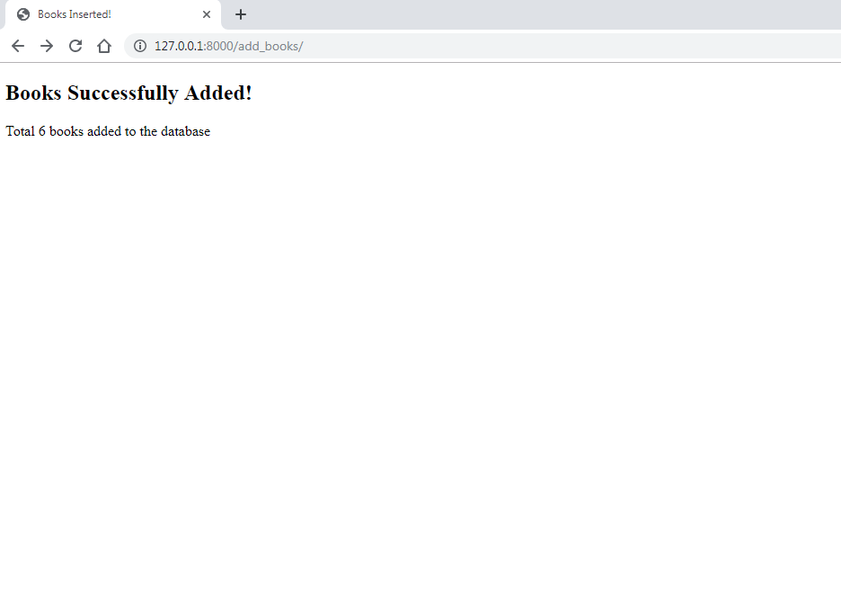
Performing Initial Steps
Following is the desired output of addbooks_result.html

Slide 22
Performing Initial Steps
Following is the code of addbooks_result.html:
<!DOCTYPE html>
<html lang="en">
<head>
<title>Books Inserted!</title>
</head>
<body>
<h2>Books Successfully Added!</h2>
Total {{count}} book{{count|pluralize}} added to the database
</body>
</html>

Slide 23
Performing Initial Steps
Also we will have to configure the url at 2 places , in the urls.py at the project level as well as in the urls.py at the app level.

Slide 24
Performing Initial Steps
In the VS Code create a new file called urls.py in the formdemoapp1 folder and write the following code in it.
Code (formdemoapp1/urls.py):
from django.urls import path
from . import views
urlpatterns = [
path('add_books/',views.addBooksView,name='add'),
]

Slide 25
Performing Initial Steps
In the VS Code open the file called urls.py in the formdemoproj1 folder and update the code in it as shown below in green.
Code (formdemoproj1/urls.py):
from django.contrib import admin
from django.urls import path,include
urlpatterns = [
path('admin/', admin.site.urls),
path('',include('formdemoapp1.urls'))
]

Slide 26
Performing Initial Steps
Now that we have added the books to the database we must design an HTML form so that user can type the subject name in it for searching books.
We will also have to tie-up this form to a view function for rendering it to the user.

Slide 27
Performing Initial Steps
To create the HTML form , do the following steps:
Go to the html file search_form.html and write the following simple HTML code in it:
<html>
<head>
<title>Search</title>
</head>
<body>
<form action="/search/" method="get">
Enter Subject Name:<input type="text" name="subject"><br>
<input type="submit" value="Search">
</form>
</body>
</html>

Slide 28
Performing Initial Steps
Now to connect search_form.html to a view function do the following:
In the views.py , create a function called searchFormView()
Write the following code in it
def searchFormView(request):
return render(request, 'formdemoapp1/search_form.html')
This code simply renders search_form.html as soon as the user types /search_books/ in the url

Slide 29
Performing Initial Steps
Now we need to create a URL conf so Django can find our new view.
To do this follow the below mentioned steps
Open the urls.py in the formdemoapp1 folder
Add the following URL pattern to this new urls.py:
from django.urls import path
from . import views
urlpatterns = [
path('add_books/',views.addBooksView,name='add'),
path('search_books/',views.searchFormView,name=searchform'),
]

Slide 30
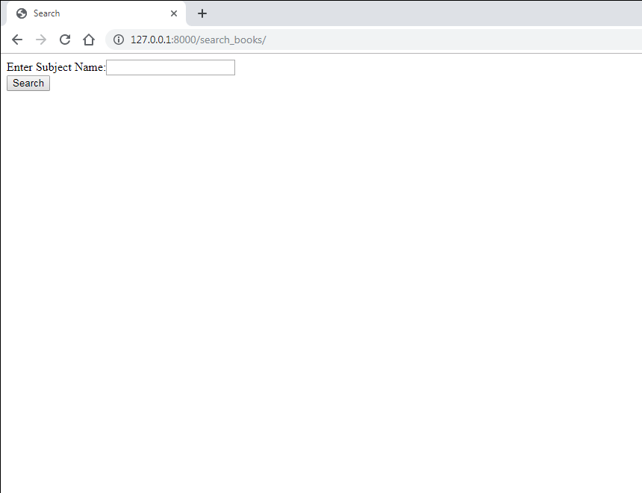
Performing Initial Steps
If we run the app and type the url http://127.0.0.1:8000/search_books then we will get the following output

Slide 31
Performing Initial Steps
Now to make the search button functional we must associate it with a view function .
This function will do the following:
Check whether the key subject is having a value or not
If it is present then using Django’s Database API retrieve all the books of the given subject
If it is not present then display the message Please submit a search term.

Slide 32
Performing Initial Steps
def searchView(request):
if request.GET['subject']!="":
subj = request.GET['subject']
books = Book.objects.filter(subject__icontains=subj)
return render(request, 'formdemoapp1/search_result.html',
{'books': books, 'query': subj})
else:
return HttpResponse('Please submit a search term.')

Slide 33
Performing Initial Steps
Now we will have to code search_result.html page in templates directory.
This page will be loaded when the user clicks the search button and shows the names of all the books belonging to that subject entered.

Slide 34
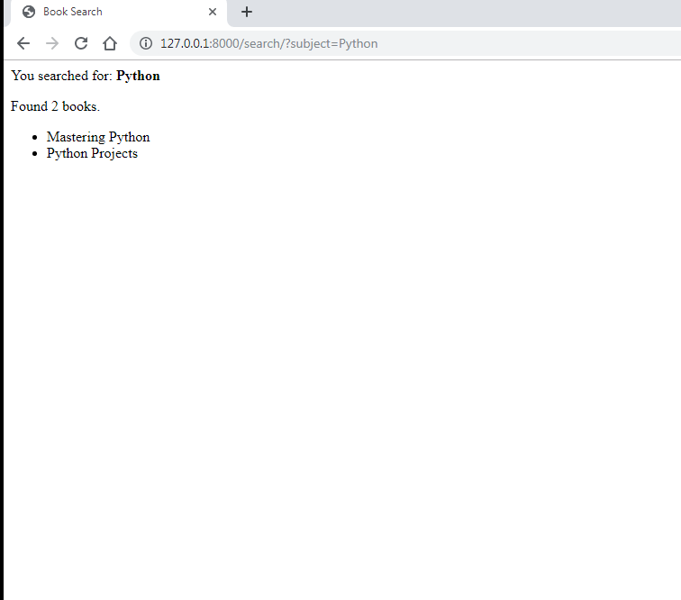
Performing Initial Steps
Following is the desired output of search_result.html assuming that the user has entered Python in the search box

Slide 35
Performing Initial Steps
Following is the code of search_result.html:
<html>
<head>
<title>Book Search</title>
</head>
<body>
<p>You searched for: <strong>{{ query }}</strong></p>
{% if books %}
<p>Found {{ books|length }} book{{ books|pluralize }}.</p>
<ul>
{% for book in books %}
<li>{{ book.book_name }}</li>
{% endfor %}
</ul>
{% else %}
<p>No books matched your search criteria.</p>
{% endif %}
</body>
</html>

Slide 36
Performing Initial Steps
Finally before running the app we must update the urls.py file in the formdemoapp1 folder and make an entry for the searchView() function
from django.urls import path
from . import views
urlpatterns = [
path('add_books/',views.addBooksView,name='add'),
path('search_books/',views.searchFormView,name='searchform'),
path('search/',views.searchView,name=search'),
]

Slide 37
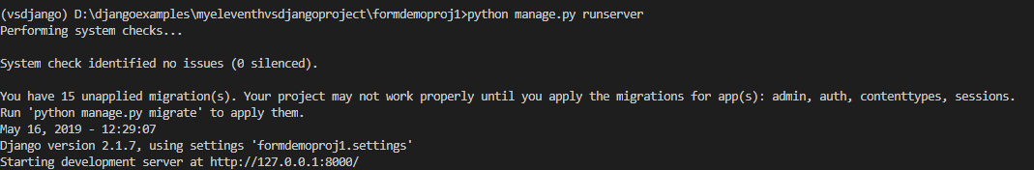
Running The Server
To run our new formdemoapp1 , go to the folder formdemoproj1 by using cd command and type the runserver command in VS Code terminal
cd formdemoproj1
python manage.py runserver.
The server runs and we’ll see output like the following output in the terminal window:

Slide 38
Opening The Page
Ctrl+click the http://127.0.0.1:8000/add_books URL in the terminal
Output window to open default browser to that address. This will load the
page addbook_result.html with the following output

Slide 39
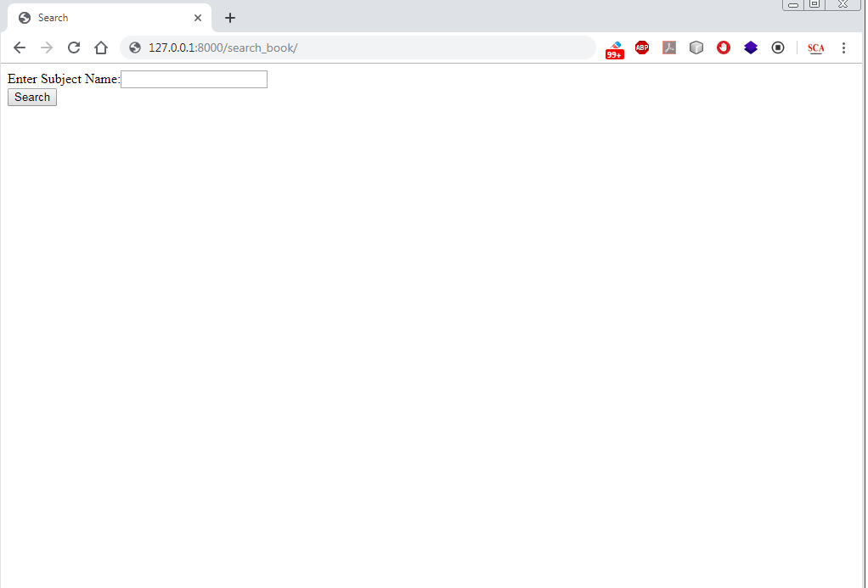
Opening The Page
Now we have to open the seacrh page , so we type the url
http://127.0.0.1:8000/search_books which will open the search
page

Slide 40
Opening The Page
Finally when we will enter subject name as Python and click the search
button , it will open the search_result.html page , which will show the
following output

